Slide 1
Reproducing reference performance
reco_command1 = "{0}/eicdirc ".format(pars.dircmacrosTopDir) + "-i " + inputfile + "-u " + lutfile + "-r 2 -timecut {} -v 2 -e 0 -trackingres 0.0005 -x mix_pik -timeres {}"
reco_command2 ="{0}/eicdirc".format(pars.dircmacrosTopDir) + "-i " + inputfile + "-u " + lutfile + "-r 4 -timecut {} -v 2 -e 0 -trackingres 0.0005 -x mix_pik -timeres {}
reco_command3 = "{0}/eicdirc ".format(pars.dircmacrosTopDir) + "-i " + inputfile + "-u " + lutfile + "-pdf " + pdffile + "-r 2 -timecut {} -v 2 -e 0 -trackingres 0.0005 -x mix_pik -timeres {}"
Events per Job = 50000
sim_command = "{0}/eicdirc -o ".format(pars.macrosTopDir) + outputFile + "-r 0 -theta {0} -x \"mix_pik\" -p 6.0 -w 0 -g 1 -h 11 -c 2031 -l 3 -trackingres 0.0005 -v 0 -gz 1 -ev 0 -b 1 -e {1}".format(inputTheta, pars.nEventsPerJob)
Timecut = 0.5, 0.05 and 0.25 ns
Timeres = 200, 100 and 10 ps

Slide 2
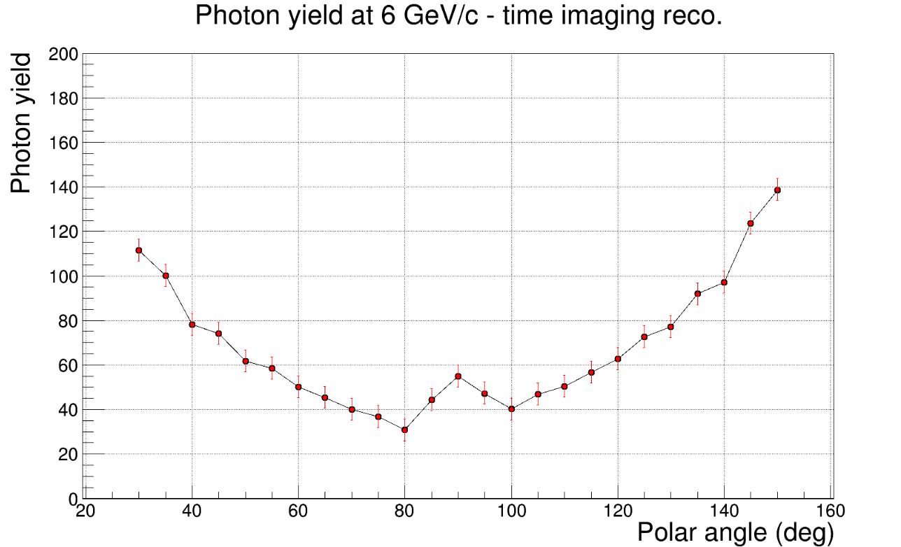
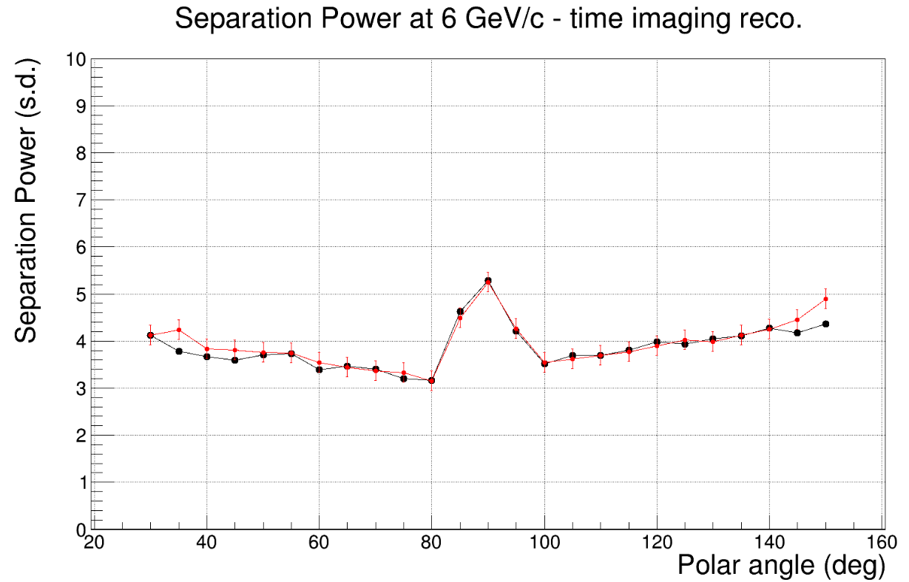
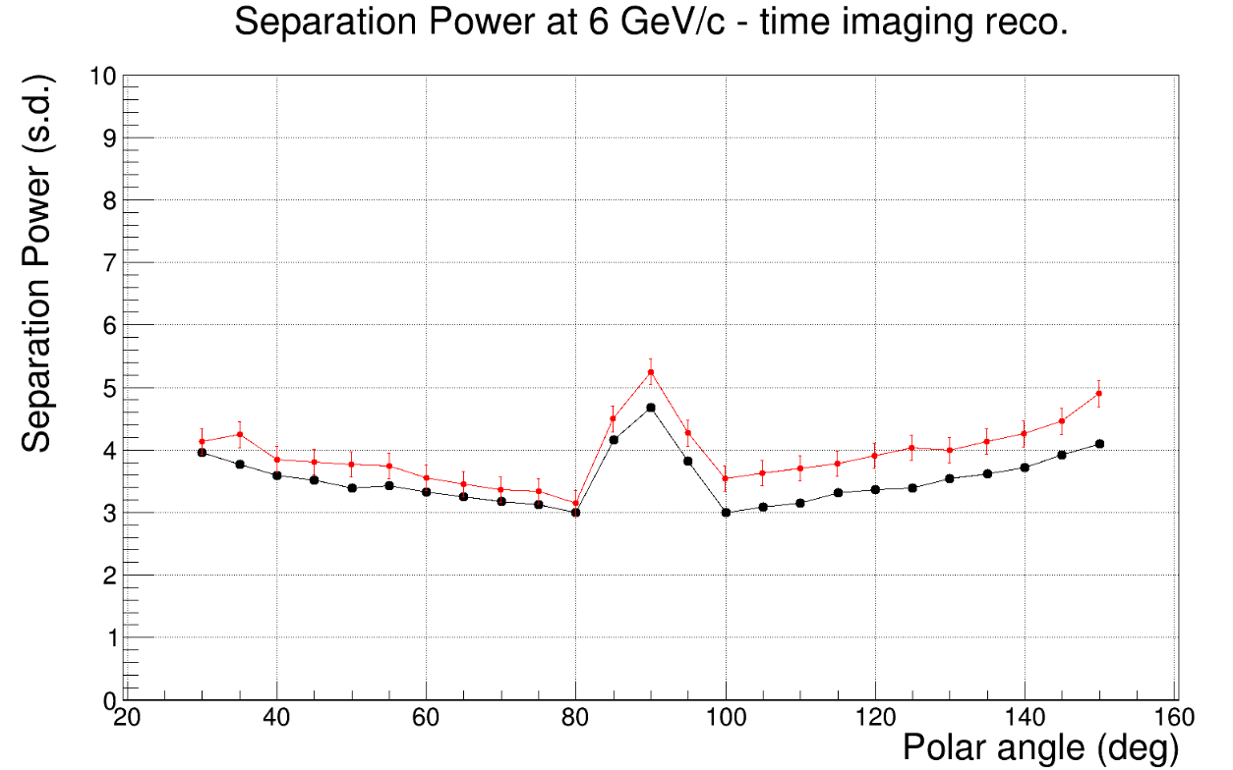
Timecut 0.5 and timeres 0.1
Timecut 0.5 and timeres 0.2

Slide 3
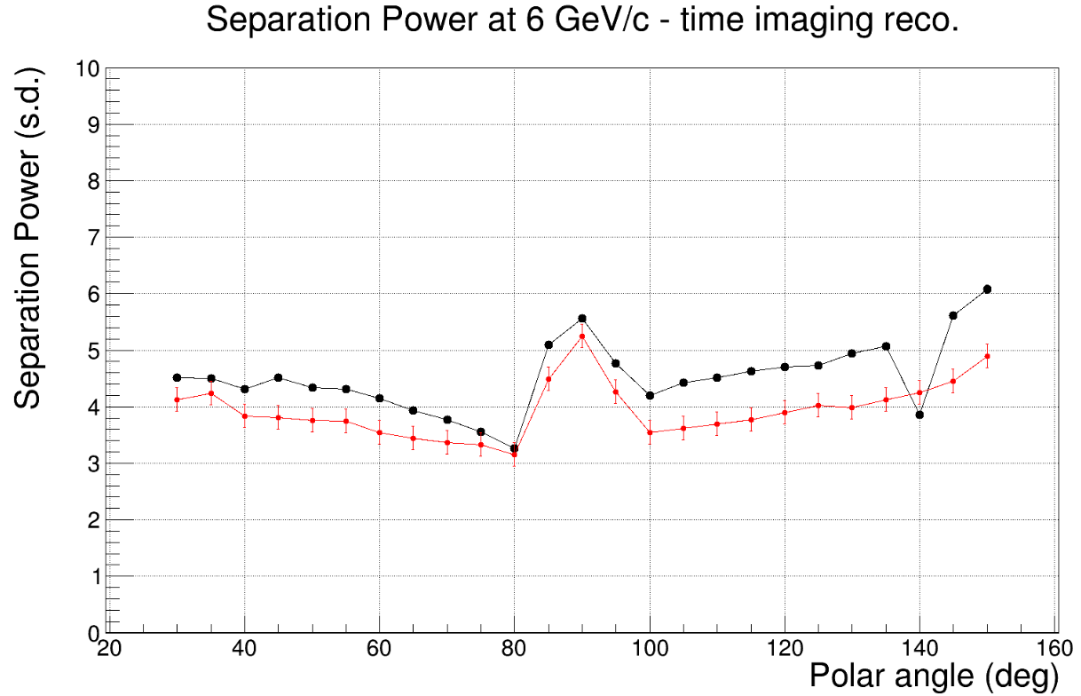
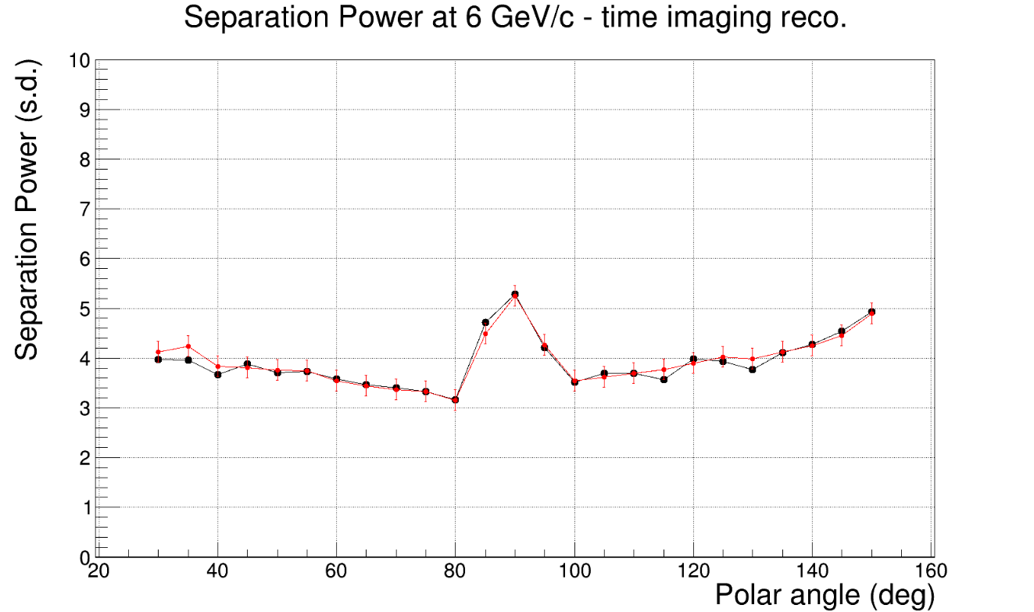
Timecut 0.5 and timeres 0.01
Timecut 0.05 and timeres 0.1

Slide 4
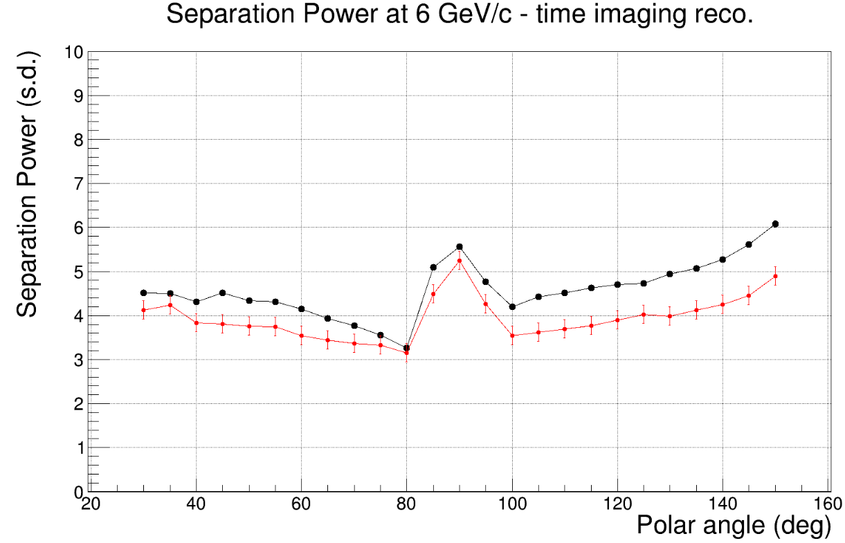
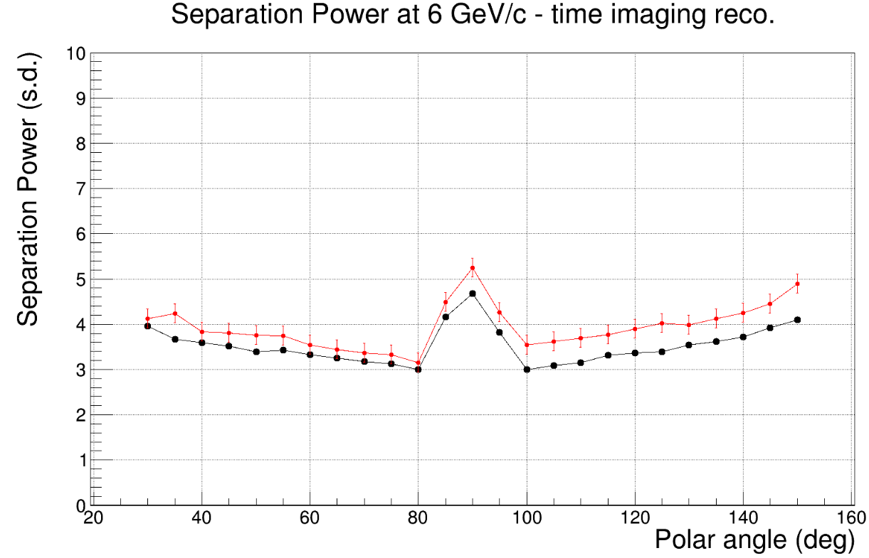
Timecut 0.05 and timeres 0.01
Timecut 0.05 and timeres 0.2

Slide 5
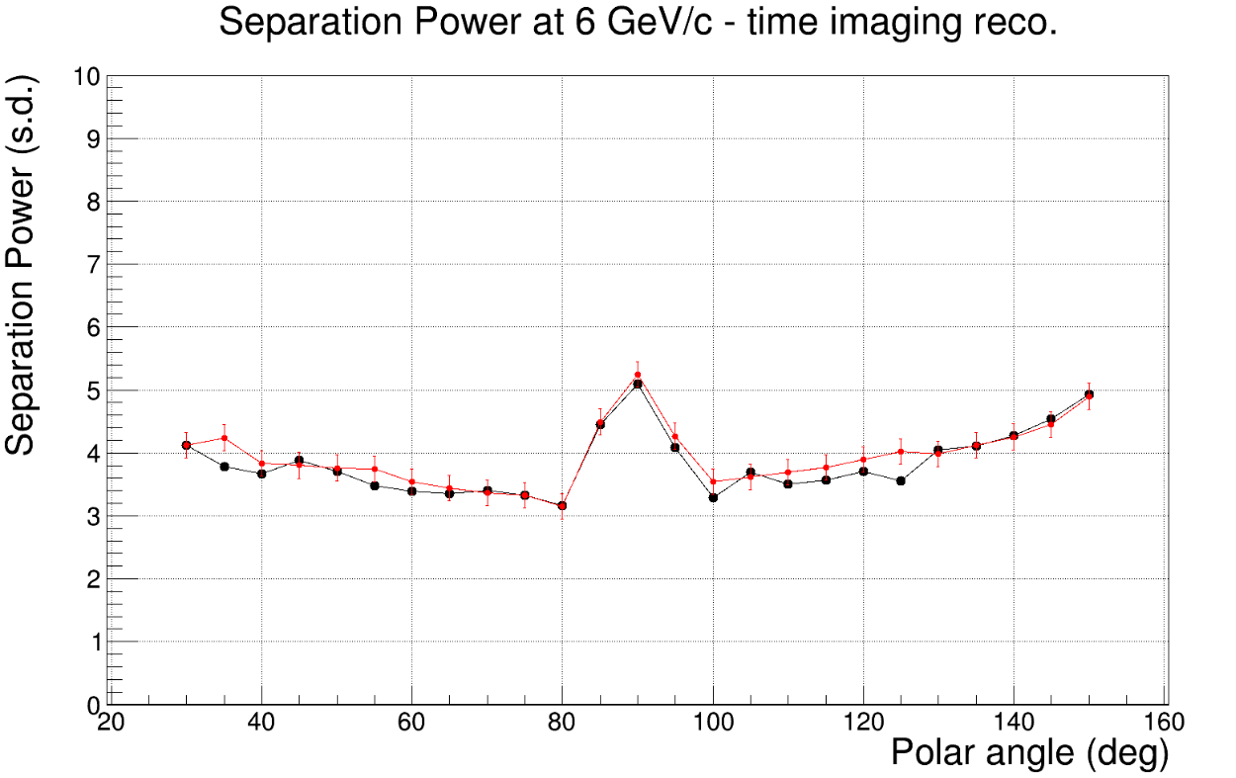
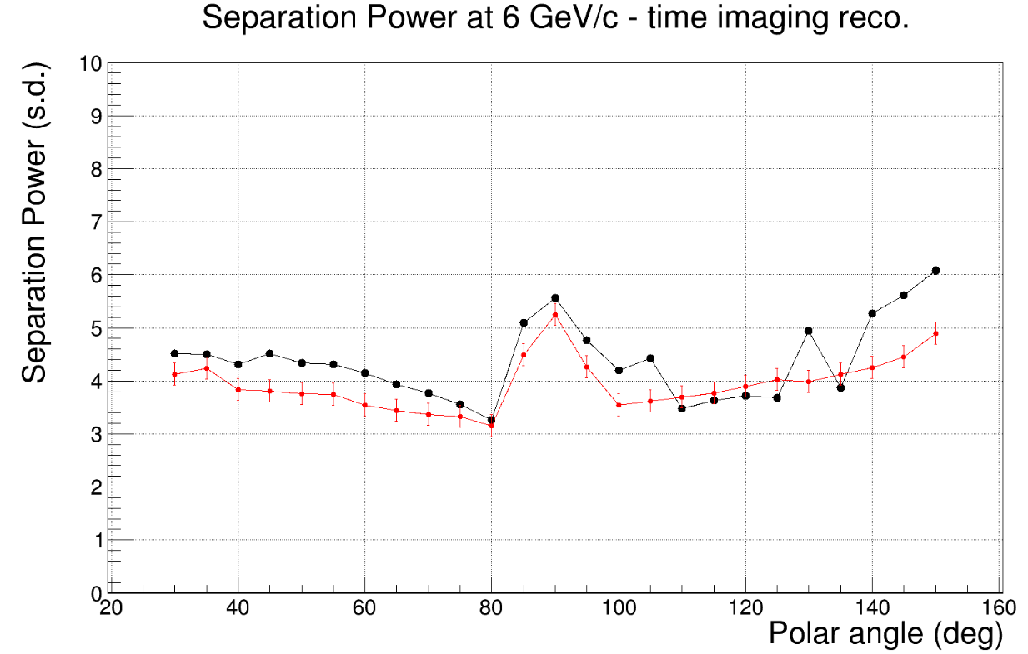
Timecut 0.25 and timeres 0.1
Timecut 0.25 ns and timeres 0.01 ns
Timecut 0.25 ns and timeres 0.01 ns
Timecut 0.25 ns and timeres 0.01 ns
Timecut 0.25 ns and timeres 0.01 ns

Slide 6
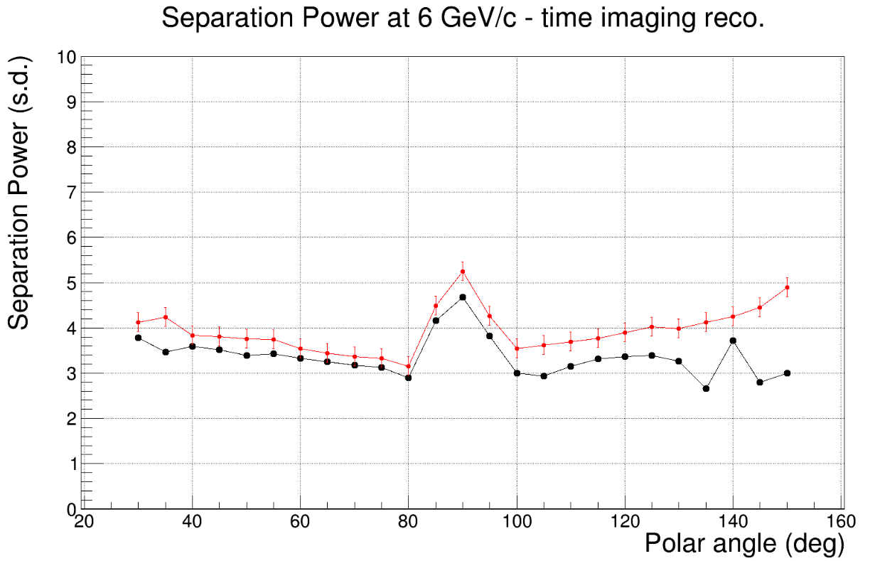
Timecut 0.25 ns and timeres 0.2 ns
Timecut 0.25 ns and timeres 0.2 ns

